Slide 1
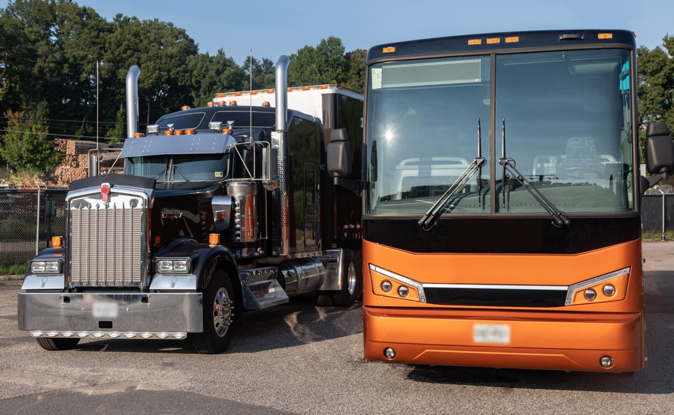


The TPR Audit Prioritization Model
March 1, 2024
Notes:
Jenny

Slide 2
What Is the Goal of the Model?
Identify training providers who:
1. Most likely under-train their drivers
2. Most severely under-train their drivers
2

Slide 3
What Is the Goal of the Model?
Rank the highest risk training providers using 3 variables:
1. Number of drivers they certified
2. Test scores distribution
3. Behind-the-wheel hours per driver
3

Slide 4






Two Types of Training Providers
  Theory
  Behind The Wheel
Driver | Test Score
Driver 1 | 80
Driver 2 | 95
Driver 3 | 82
Driver 4 | 100
… | …
Driver | BTW Hours
Driver 1 | 2
Driver 2 | 5
Driver 3 | 11
Driver 4 | 8.5
… | …
4

Slide 5
#1 Theory Providers Model Output
Provider | Count of Drivers Trained | Number of Distinct Scores | Probability
Provider # 1 | 41247 | 18 | 1.139235347e-13
Provider # 2 | 15728 | 18 | 1.139235347e-13
Provider # 3 | 10309 | 16 | 9.219488130e-25
Provider # 4 | 9424 | 14 | 6.362131987e-38
… | … | … | …
Provider # 11 | 4335 | 15 | 4.610868764e-31
Provider # 12 | 4152 | 3 | 1.996742110e-200

Slide 6

#1 Theory Providers – Risk Indicators
N = 21
k = Number of drivers trained
d = Number of distinct score
S = Stirling number of the second kind
Number of Drivers Trained
  Probability
  Severity
6

Slide 7
#2 BTW Providers Model Output
Provider | Count of Drivers Trained | Hours Percentile | Mean BTW Hours
Provider # 1 | 6367 | .032756 | 2.041621
Provider # 2 | 3236 | .009662 | 1.256833
Provider # 3 | 3018 | .075513 | 3.785785
Provider # 4 | 3017 | .07522 | 3.763175
… | … | … | …
Provider # 11 | 1835 | .04962 | 2.995095
Provider # 12 | 1776 | .179583 | 6.464527
Notes:
Jenny

Slide 8
#1 BTW Providers – Risk Indicators
Bottom 20th Percentile of BTW Hours
Number of Drivers Trained
  Probability
  Severity
8

Slide 9
Contact Us: ​
Philip.Situmorang@dot.gov
Thank You!

